Slide 1
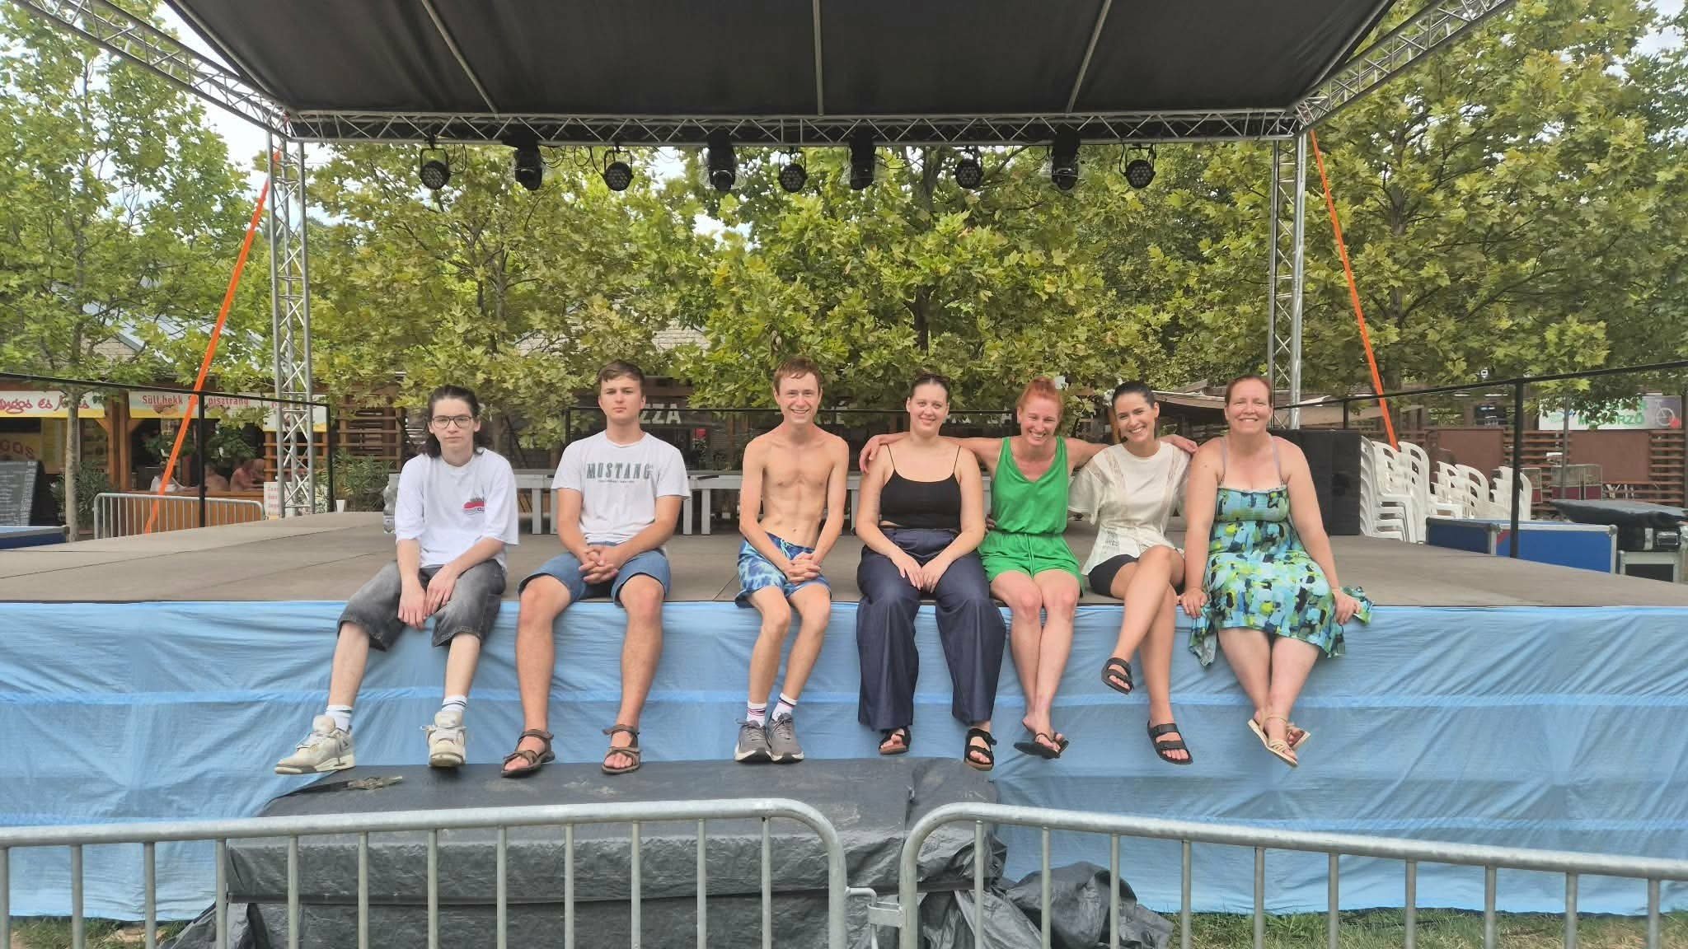



WHAT HAPPENS,
when a cultural institution does more than just organise programmes…
when it creates space for ideas?
pARTvonal + PONT Youth Club
Vágfalvi Ottó Cultural Centre, Library and Tourism Centre
Photos: event photos provided for the presentation

Slide 2
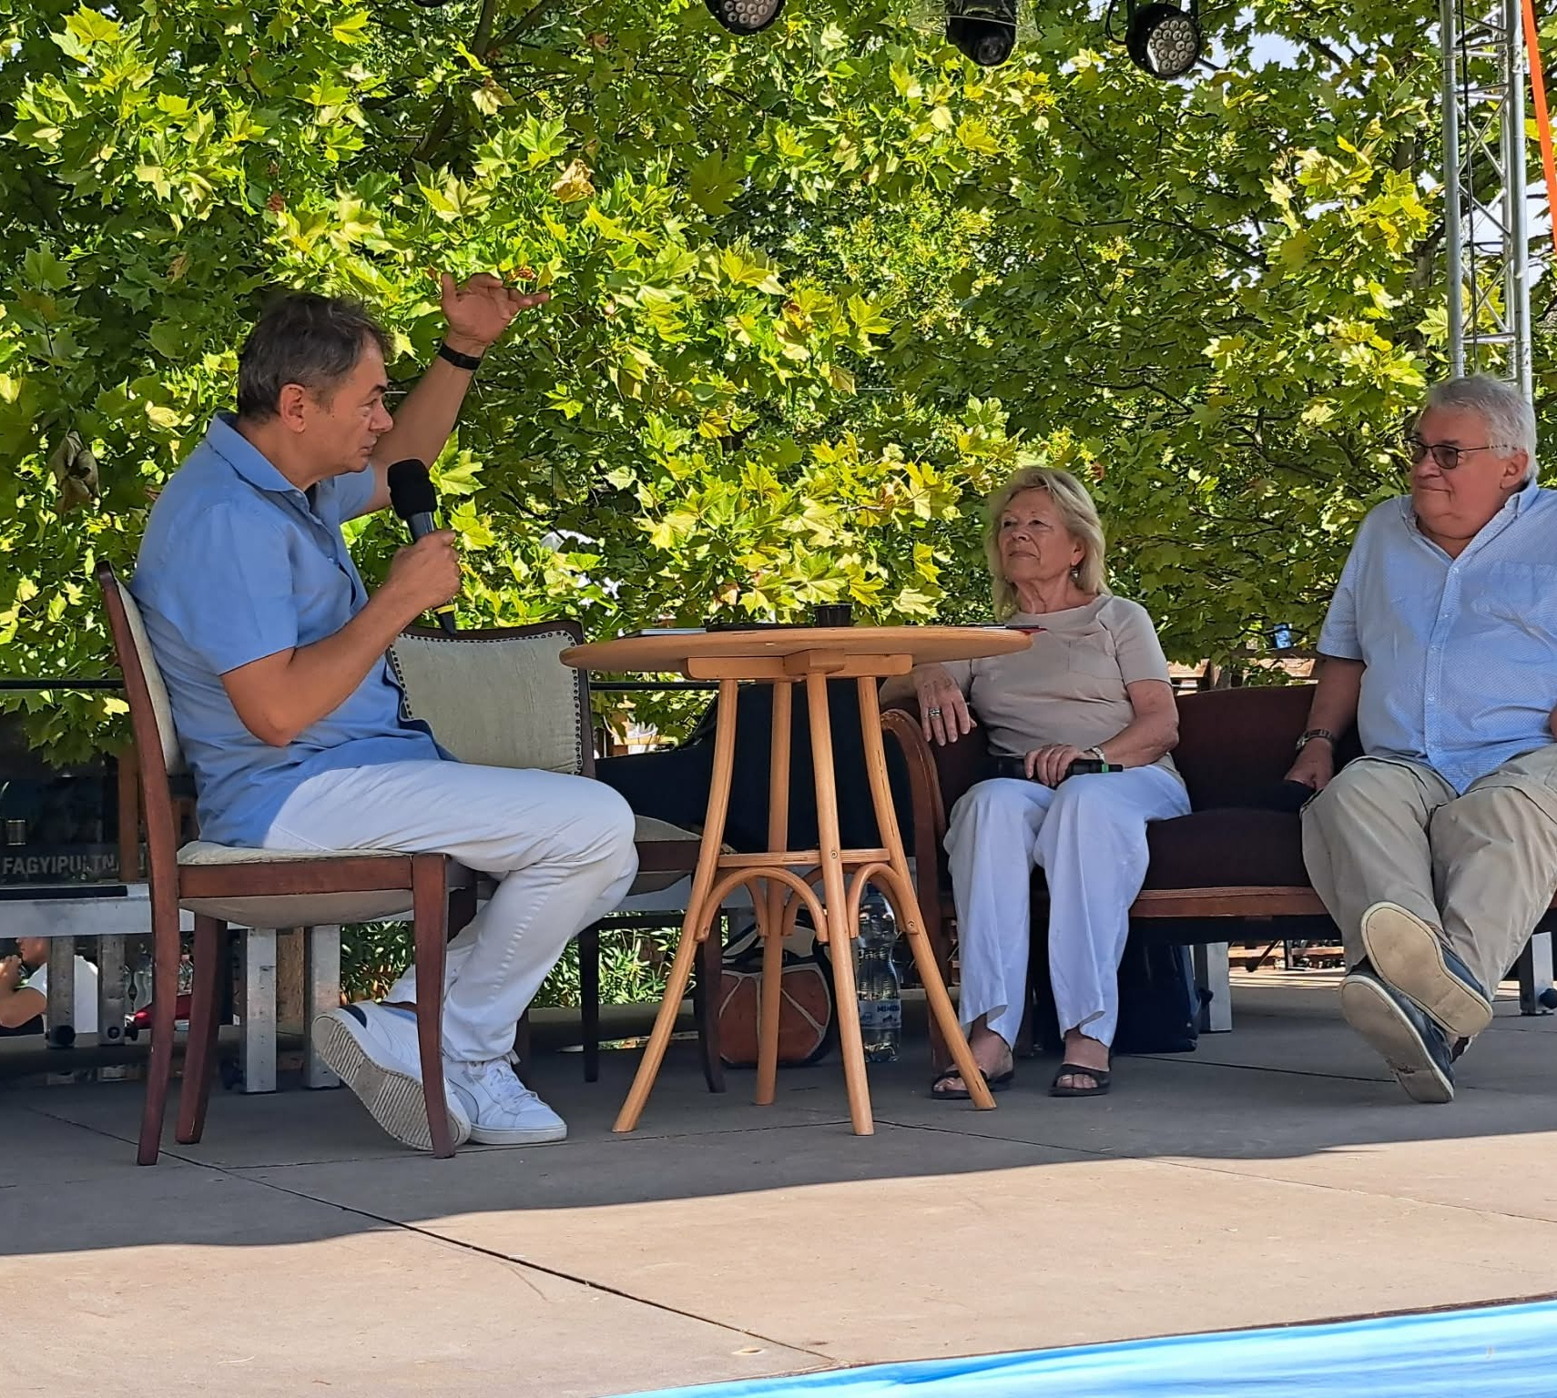
pARTvonal
From a local asset to a shared experience.
Art became more than something to look at —
it became a shared activity.
6
artists
60
participants
5,5 × 8 m
collaborative artwork
TANDEM • BALATONFŰZFŐ
02

Slide 3
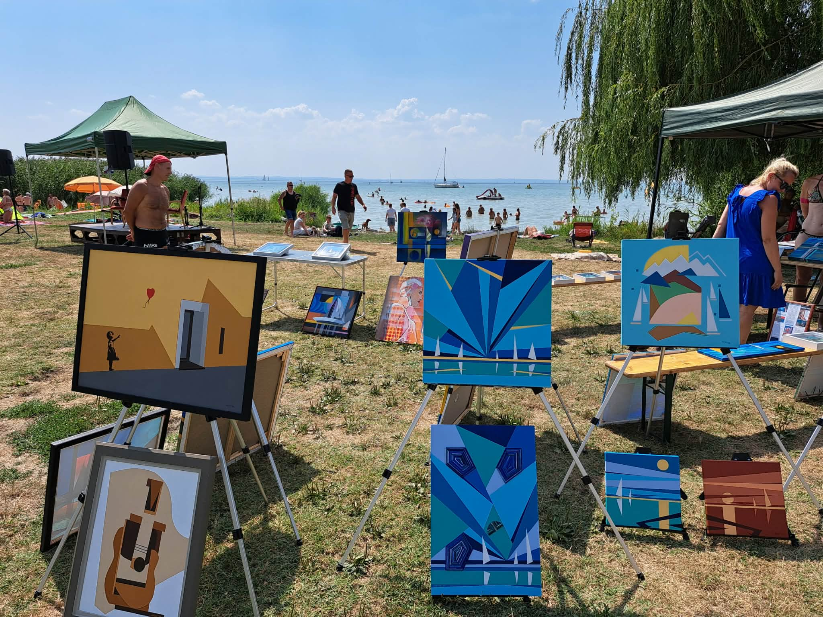
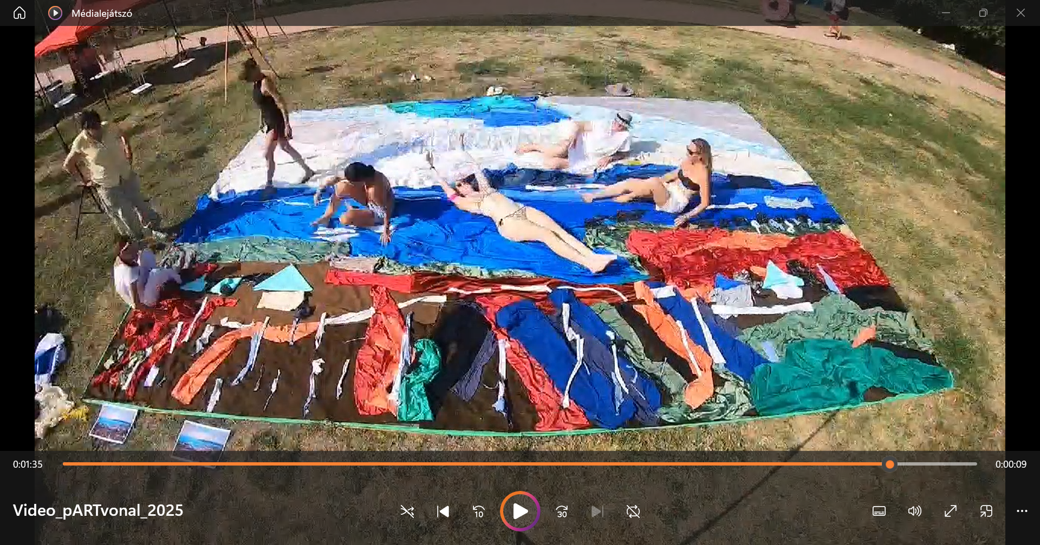
THEY DIDN’T JUST WATCH.
THEY CREATED.
The audience became participants.
A local heritage asset became a community experience.
TANDEM • BALATONFŰZFŐ
03

Slide 4
What makes it work?
Local asset
Open space
Collaborative creation
Taking it further
The artistic heritage of Ottó Vágfalvi
Artists + audience + place
You don't have to be an expert
The programme inspires new ideas
A good practice is not a recipe.
It is rather a question: „What could this become in our community?”
TANDEM • BALATONFŰZFŐ
04

Slide 5
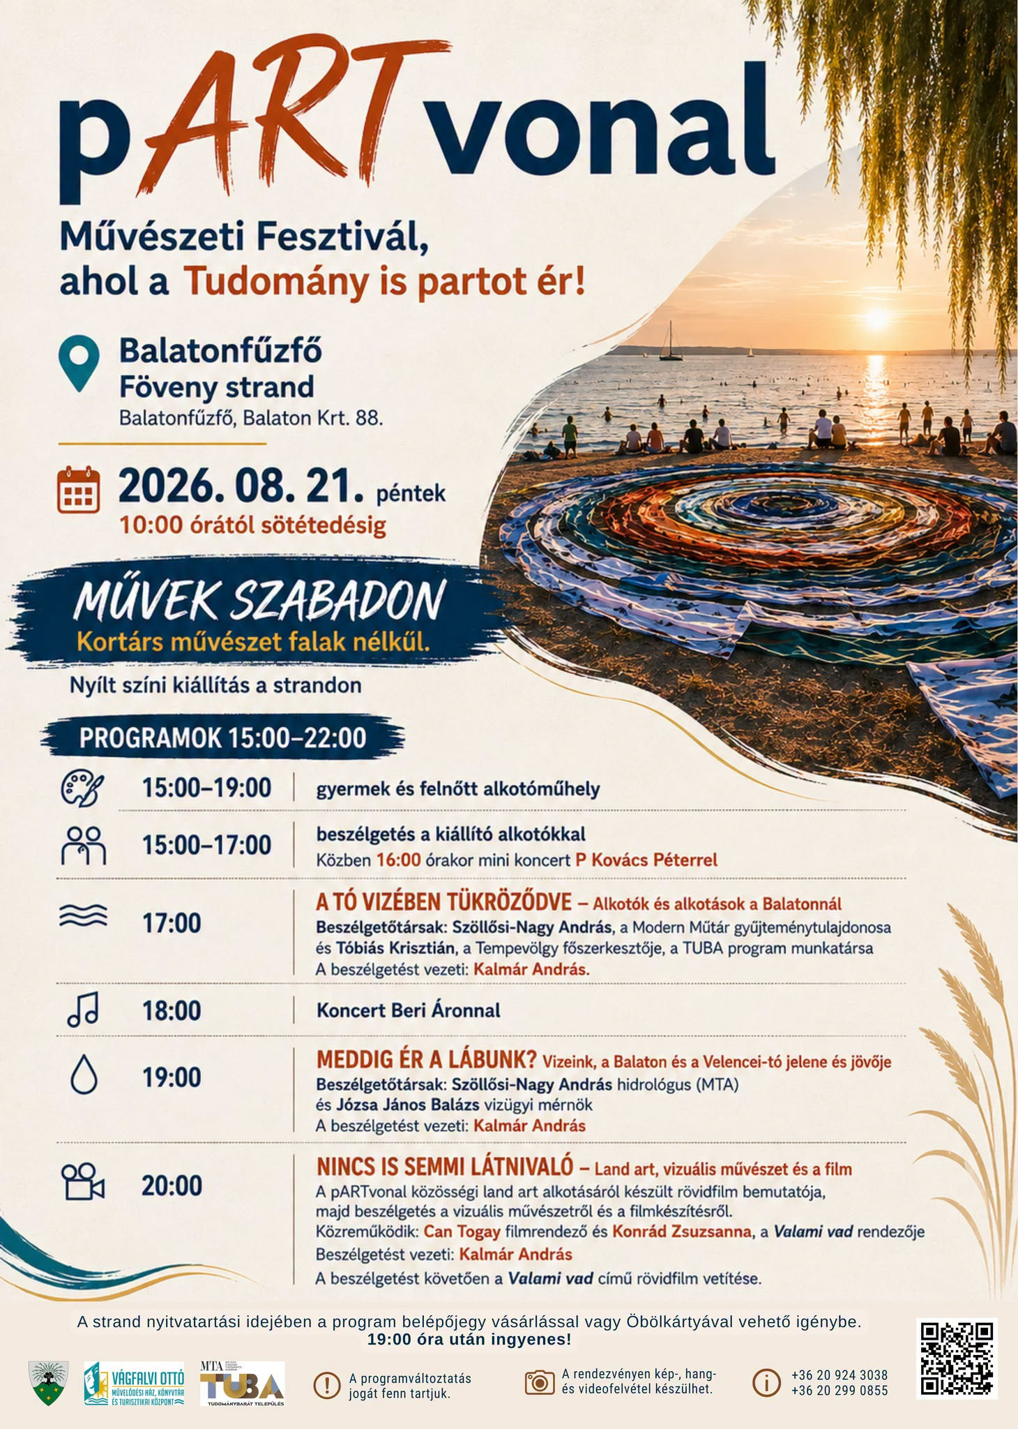
pARTvonal
Not just one programme,
but an idea that keeps evolving.
Contemporary art • discussion • workshop • music • collaborative creation
The 2026 programme continues to build connections between the community and the arts.
„Art became participation.”
Programme poster – 21 August 2026
TANDEM • BALATONFŰZFŐ
05

Slide 6
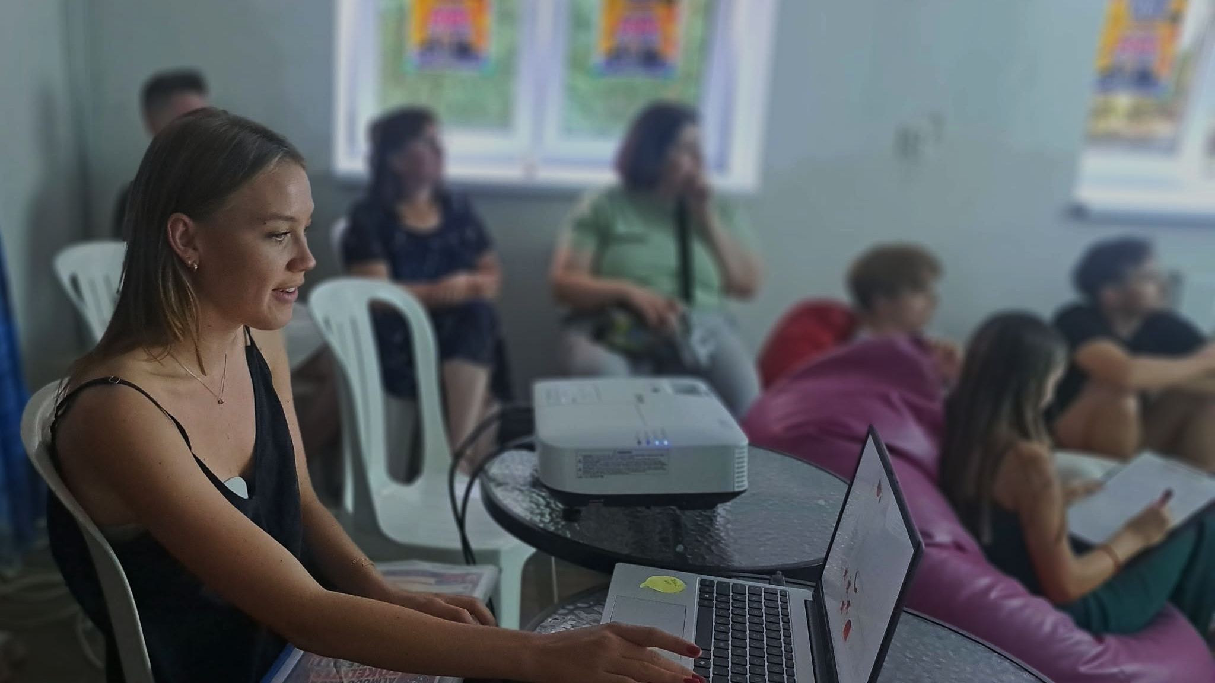

PONT YOUTH CLUB
Just the right place, just for you
What if young people were given more than just programmes…
what if they had a space of their own?
Photos: event photos provided for the presentation
TANDEM • BALATONFŰZFŐ
06

Slide 7
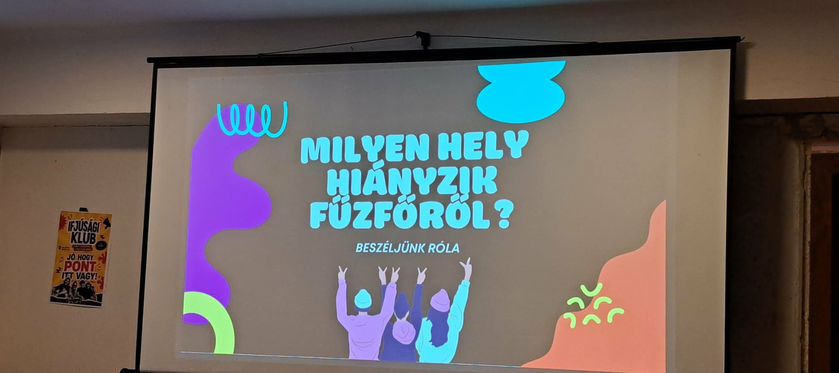
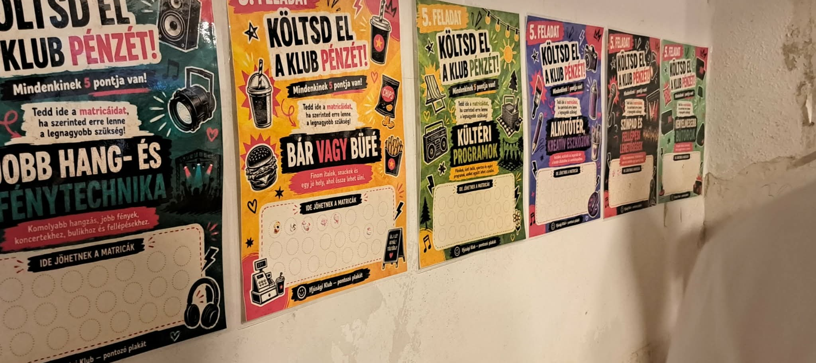
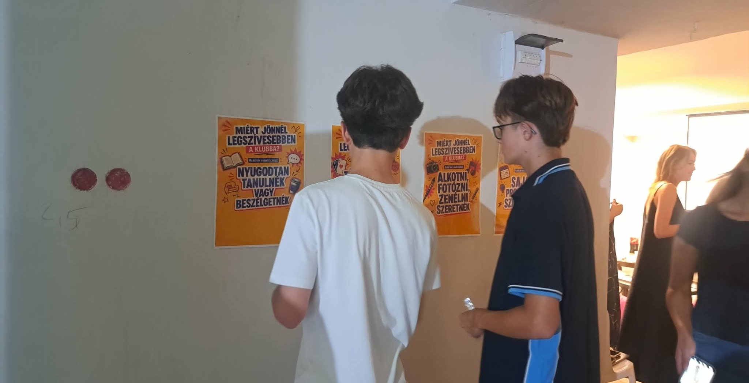
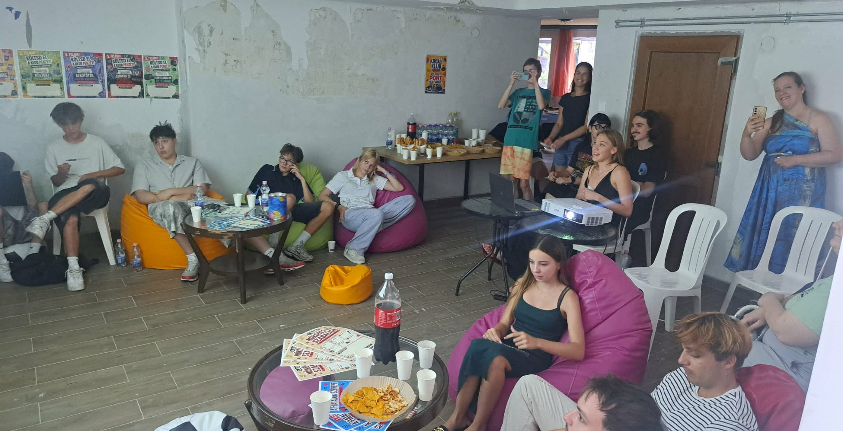
PONT is already asking questions, involving young people and encouraging them to take action.
TANDEM • BALATONFŰZFŐ
07

Slide 8
PONT: THE SPACE IS THEIRS – LET THEM SHAPE IT!
Play & leisure
Creation
free time, meeting others
their own ideas, self-expression
Community
Participation
informal connections
TÉRítők: young people as the shapers of the space
The PONT Youth Club is an initiative currently being developed — and that is precisely why it is a good TANDEM example: a community idea can be shaped and developed along the way.
TANDEM • BALATONFŰZFŐ
08

Slide 9
AND WHAT ABOUT YOU?
•
Do you have a local story?
•
Do you have a forgotten place?
•
Is there someone whose knowledge is valuable?
•
Is there a community that still lacks a space of its own?
•
Do you have an idea that nobody has tried yet?
In TANDEM, we are not looking for ready-made recipes.
We are looking for ideas that can inspire something new in your own community.
TANDEM • BALATONFŰZFŐ
09

Slide 10
YOU DON’T HAVE TO DO EVERYTHING AT ONCE.
1
2
3
ASK!
CREATE SPACE!
TRY IT!
Even a small idea can become a community practice.
The project is funded by the European Union.
TANDEM • BALATONFŰZFŐ
10

Slide 11

We continue in Balatonfűzfő!
TANDEM • BALATONFŰZFŐ

