Slide 1



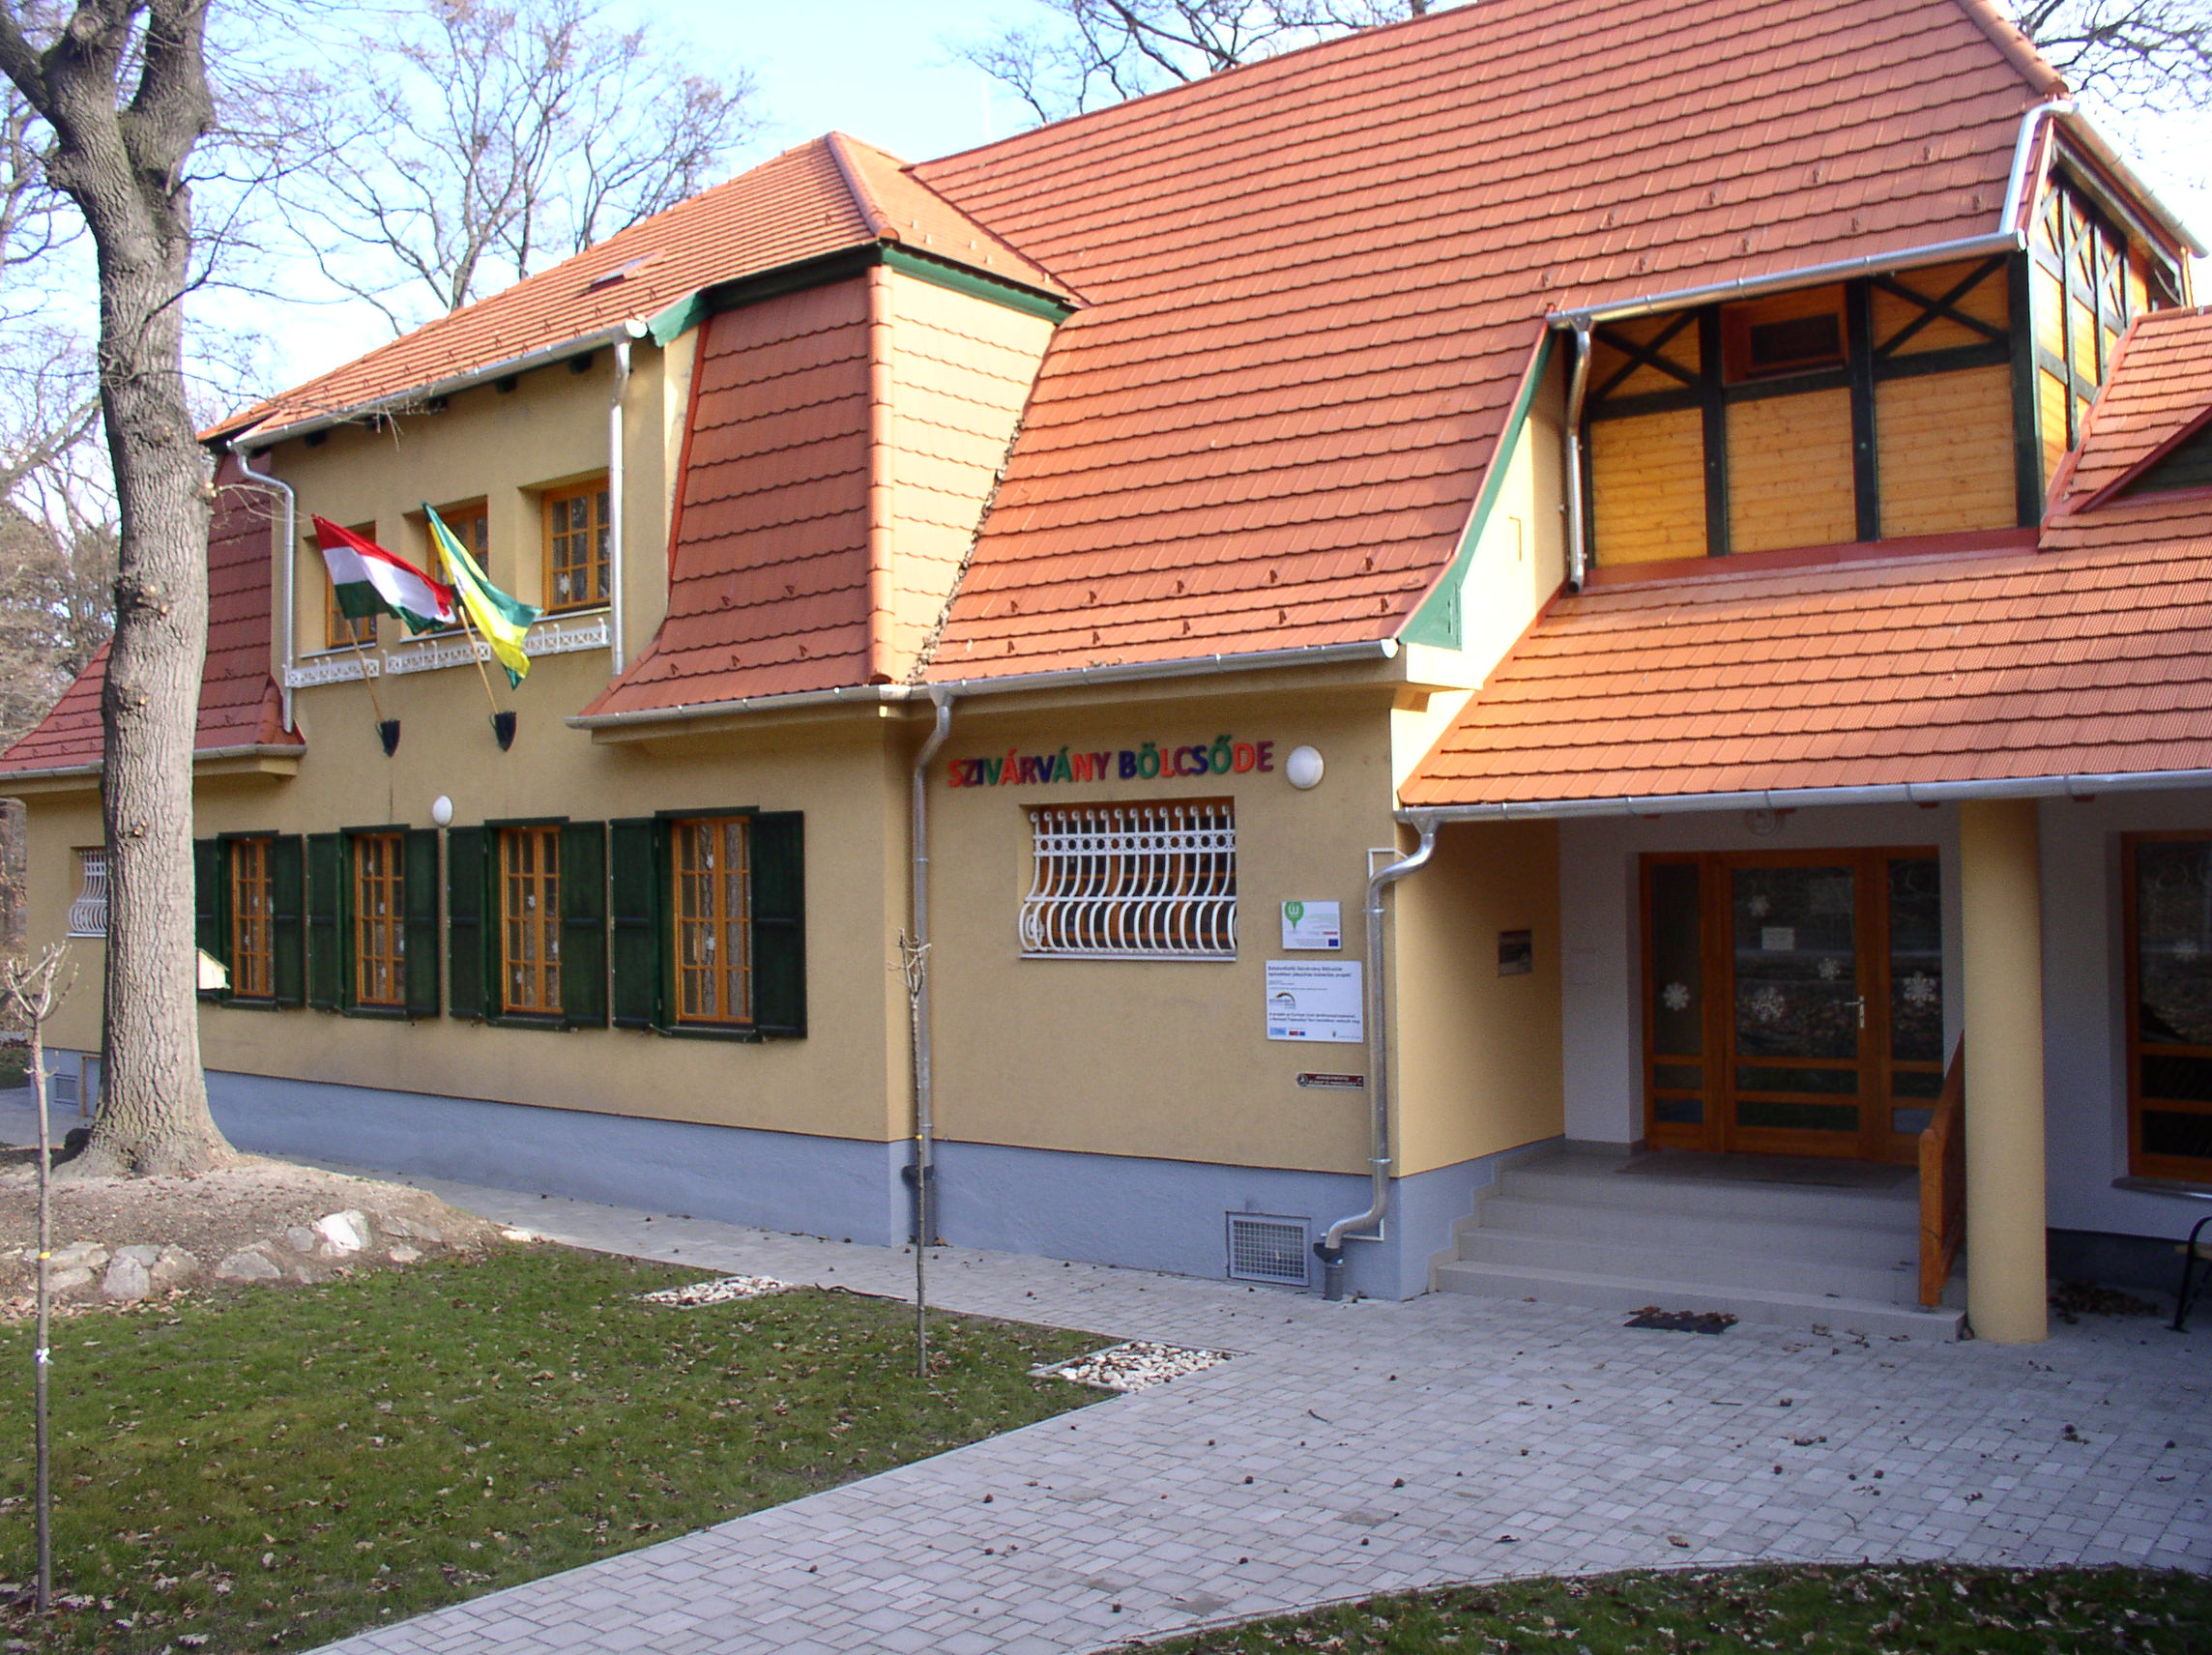
„SULIVÁRÓ”/”School Welcome”
when school already feels familiar in kindergarten
Balatonfűzfő • GOOD PRACTICE • 2026

Slide 2
It started with a simple question
What happens when school is NOT an unfamiliar place?
THE CHILD
Gets to know the new environment
Gains positive experiences
Can ask questions and explore
Develops a sense of security
THE FAMILY
Can get involved
Gets to know the school
Makes the decision and transition easier
THE EDUCATORS
Coordinate their work
Get to know each other’s practices
Jointly support the child
Balatonfűzfő • GOOD PRACTICE • 2026

Slide 3
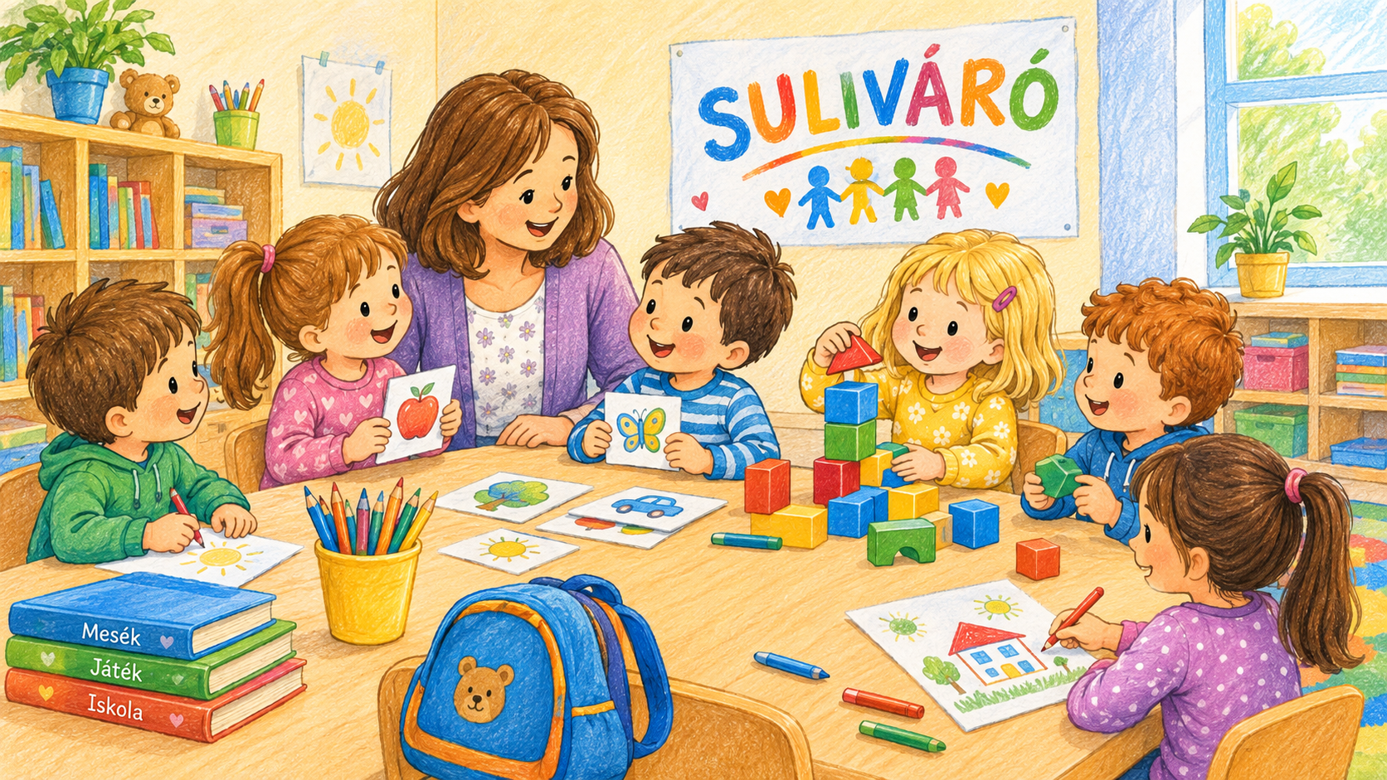
„SULIVÁRÓ”/”SCHOOL WELCOME” is not a single event
IT IS A JOINT PROJECT WITH THE PRIMARY SCHOOL THAT COVERS THE ENTIRE SCHOOL YEAR
1. Getting to know each other
School visits, cultural activities and personal connections
2. Building connections
Cooperation between kindergarten and primary school teachers
3. Parental involvement
The family is not an outsider, but a partner
4. Follow-up
The kindergarten keeps track of the child’s adjustment
Balatonfűzfő • GOOD PRACTICE • 2026

Slide 4
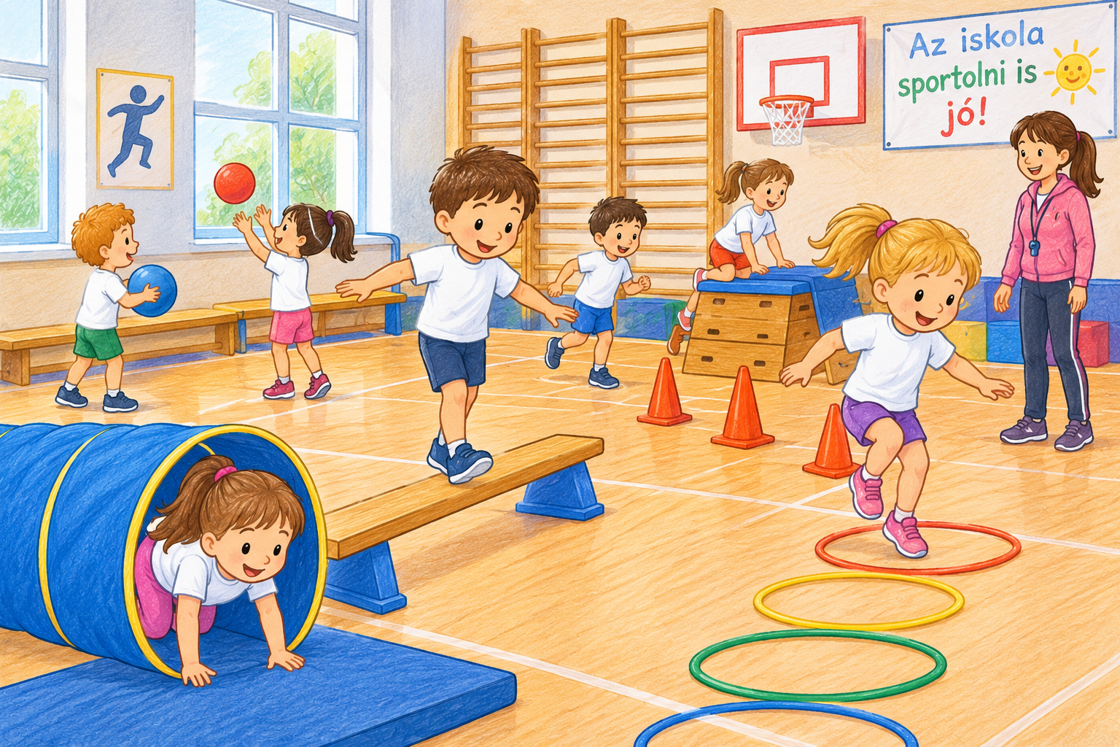
What is the real result?
Not that the child should become a “schoolchild” sooner.
But that…
the name of the school already sounds familiar
the child knows where they are going
parents know who they can talk to
educators understand each other’s perspectives
the transition becomes a shared story
Balatonfűzfő • GOOD PRACTICE • 2026

Slide 5
Why can it be adapted by other communities?
LOW RESOURCE REQUIREMENTS
No new building is needed.
No complicated system is needed.
Above all, it requires time, attention and cooperation.
ADAPTABLE TO LOCAL NEEDS
The name of the programme can be different,
as can the location or the range of activities –
the underlying approach remains the same
BUILDS COMMUNITY
Child + family + kindergarten + school
become part of the same process.
Balatonfűzfő • GOOD PRACTICE • 2026

Slide 6
What we learned from it
A GOOD TRANSITION IS BUILT ON RELATIONSHIPS
MEETING
First, we get to know each other.
EXPERIENCE
Positive experiences reduce the fear of the unknown.
TRUST
The child, the family and the educators can all feel secure together.
COMMUNITY
School becomes not just an institution, but the child’s next community.
Balatonfűzfő • GOOD PRACTICE • 2026

Slide 7
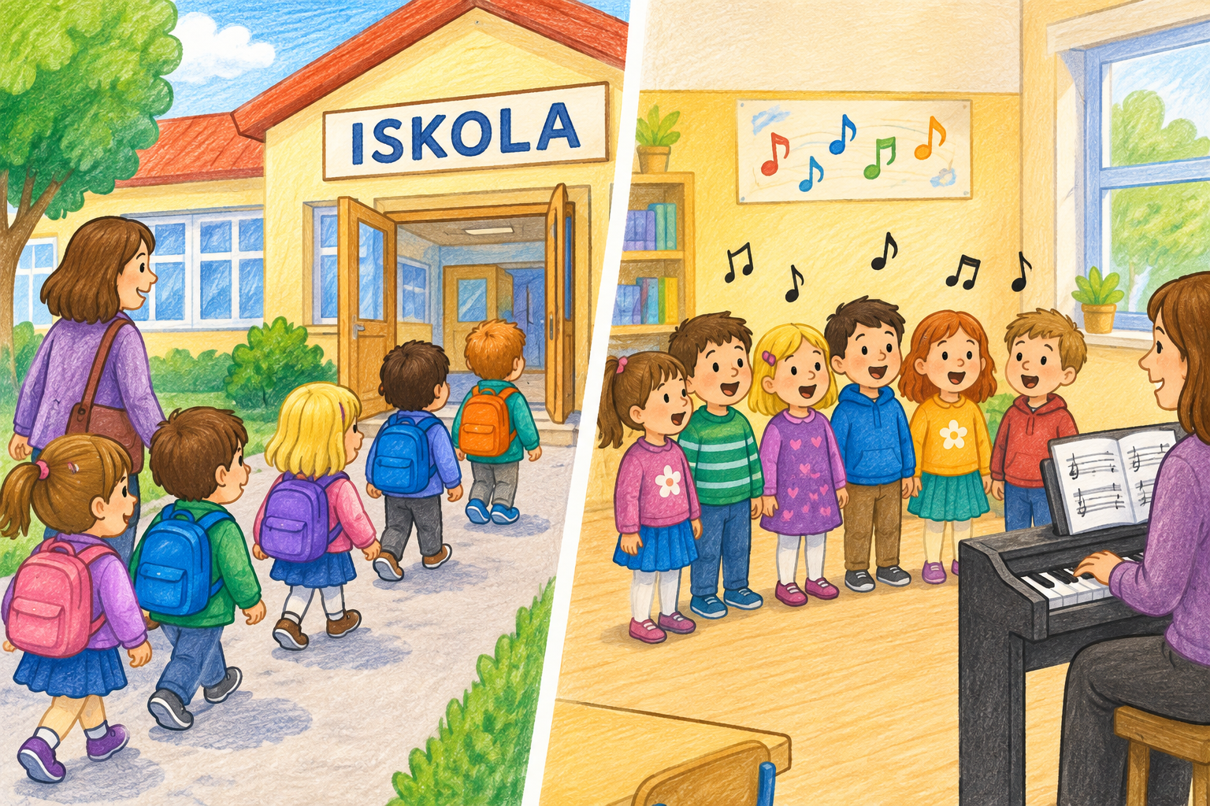
Closing thought
The goal is not for a child to become a schoolchild while still in kindergarten.
The goal is that when the time comes to start school, they do not arrive at an unfamiliar place.”
.
Balatonfűzfő • GOOD PRACTICE • 2026

Slide 8

The story does not end here…
This is where we continue in Balatonfűzfő!
We look forward to welcoming you!
Balatonfűzfő • GOOD PRACTICE • 2026

